Slide 1
Neural & Adaptive Systems
Final Project – Part A
Aadarsh Vadakattu - 16254183

Slide 2
Importing dataset
After extracting the zip file, I iterated manually through the code “datasetimporter.m” for 40 times, once for each subject. For example, to import Subject 40’s information, I imported the 10 pgm files one by one for S40, which had details in terms of x1, x2 and so on upto x10, representing each pgm file. I simply opened the pgm file in MATLAB and imported each x by clicking ‘finish’ of the import wizard for all pgms.
Then, the code in datasetimporter.m pulls all the data into a single cell, like this:
c40={x1,x2,x3,x4,x5,x6,x7,x8,x9,x10};
I also saved all the cells info in the file “all_cells.m”

Slide 3
Creating variables
Using the file “variablecreator.m”, I created all the necessary variables (c and cTest) for training and testing. I have also saved the input values of training(c) and testing(cTest) into the file “variables.mat”

Slide 4
Final code
The code “final.m” contains the final implementations of the program and is linked to ezroc3 at the end to generate ROC curves. The inputs required to this file are c and cTest in my case (c is the part of first 6 images of the subjects for training and cTest in the next 4 images for testing).
I implemented 5 different configurations to find out different pairs of training and testing ROCs and are as follows:

Slide 5
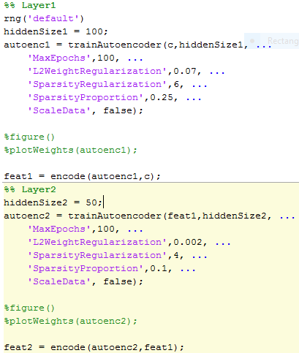
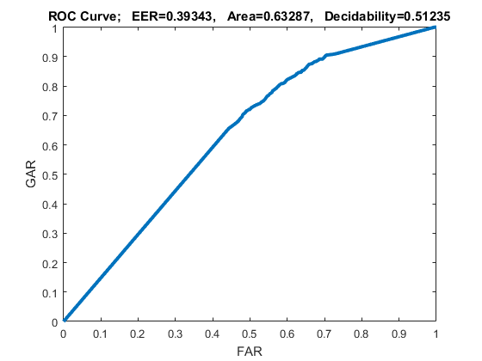
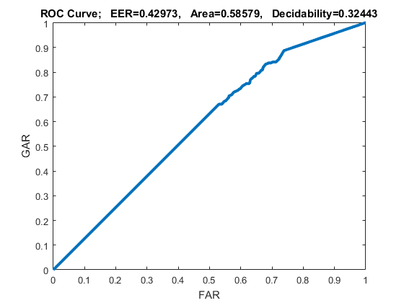
Configuration 1
Training ROC
Testing ROC

Slide 6
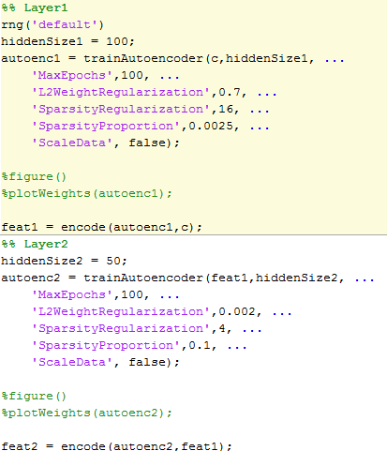
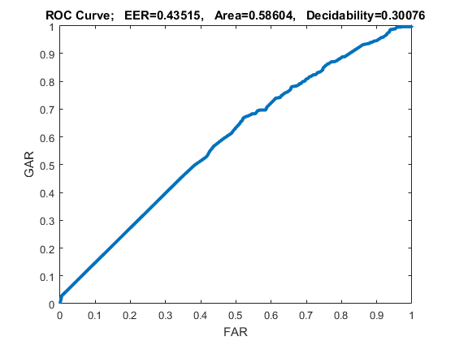
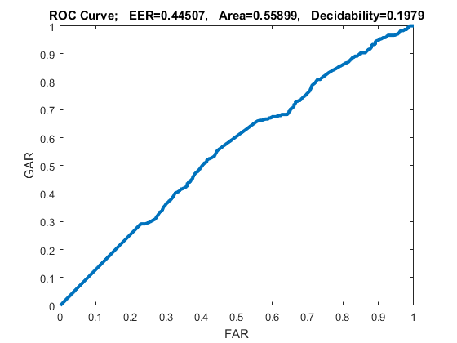
Configuration 2
Training ROC
Testing ROC

Slide 7
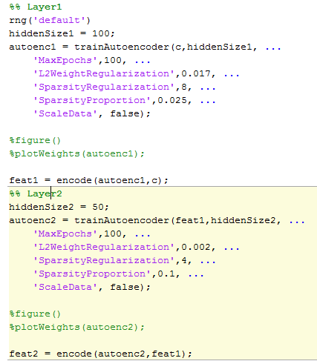
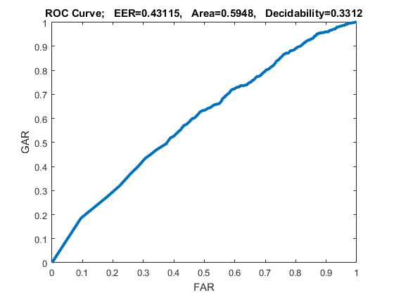
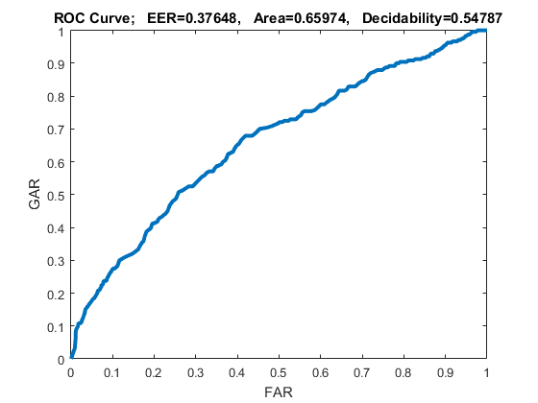
Configuration 3
Training ROC
Testing ROC

Slide 8
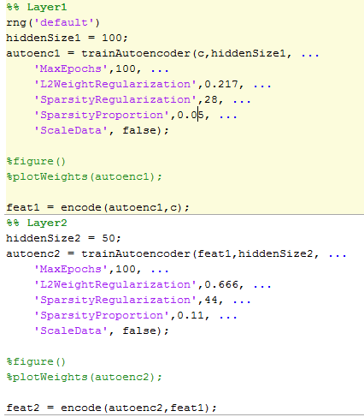
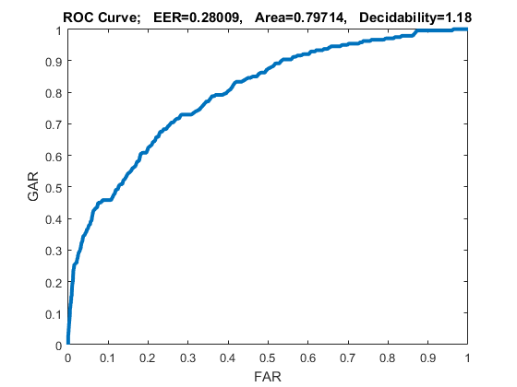
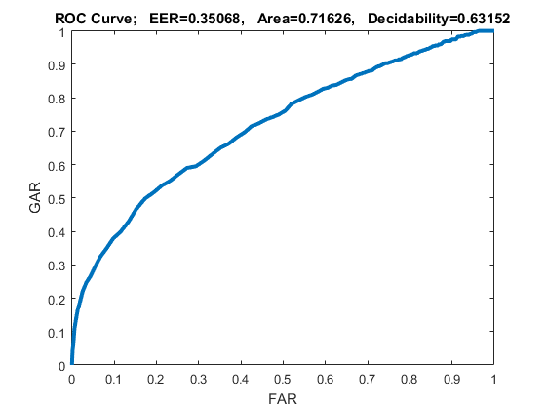
Configuration 4
Training ROC
Testing ROC
Best Results

Slide 9
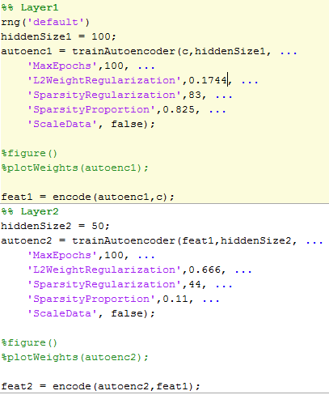
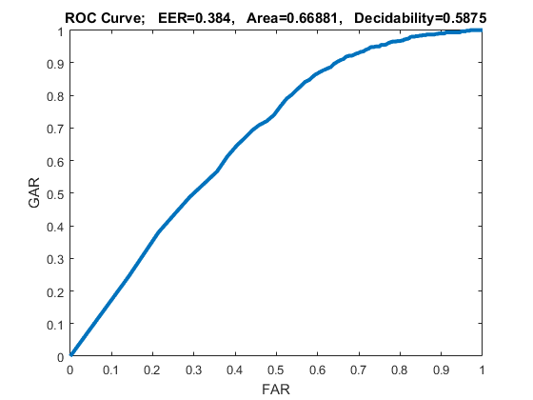
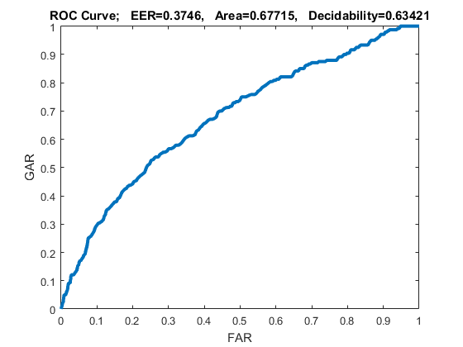
Configuration 5
Training ROC
Testing ROC

